Slide 1

VENUE PARTNER PROGRAM
A room full of local real estate pros, one weeknight a month.
REMEx brings the crowd, the speakers and the promotion. Your restaurant brings the room and gets named on everything.
Now booking host venues
Connecticut
remexct.com · events@remexct.com · 914-409-5555

Slide 2
WHAT REMEX IS
A free networking and education night for Connecticut real estate and mortgage professionals.
Thursday nights
Education first
Free to attend
6 to 8 PM. The 2nd, 3rd and 4th Thursdays are open to host venues.
Two 20-minute talks the room can use on Monday. No sales pitches.
Sponsors cover the night, so nothing stands between a pro and your door.
REMEx · Venue partners · 2

Slide 3
WHO WALKS THROUGH YOUR DOOR
The people who host client dinners, celebrate closings and book office parties
Real estate agents
Loan officers
Real estate attorneys
Title and escrow
Inspectors and appraisers
Insurance
Contractors and trades
Investors
Property managers
Extensive
email contact list of Connecticut real estate and mortgage pros, and growing. Every area's night goes out to it. Invites, follow-ups, post-event emails and review requests all carry your name.
REMEx · Venue partners · 3

Slide 4
WHY HOST
What a REMEx night does for your restaurant
01
02
A full room on a Thursday
Guests who come back
6 to 8 PM on a weeknight. Capacity is set by your space.
Pros book client dinners and office parties where they've already been.
03
04
Promotion you don't pay for
Your photos, shared for you
Your name goes out by email, Eventbrite, Meetup, the web and social media.
Send us photos of your room and food. They go into the recap and social posts.
REMEx · Venue partners · 4

Slide 5
YOUR NAME, EVERYWHERE
Where your restaurant appears
BEFORE
ON THE NIGHT
AFTER
Email invitations to our extensive, growing contact list of local pros
Thanked by name from the front
Recap post with your photos
Your gift cards drawn in your name
Social posts tagging your restaurant
Eventbrite, Meetup, remexct.com and many other event sites
Your specials on a table card, if you want one
Post-event graphics for your social media
Facebook, LinkedIn and Instagram
Pros posting from your room
Listed for good on our Past Hosts page
Ready-made posts we supply for your own social media
A venue report of what the night produced
REMEx · Venue partners · 5

Slide 6
THE NIGHT
Same two-hour run of show every time
6:00 PM
6:30 PM
6:40 PM
7:20 PM
7:30 PM
Arrive and mingle
Welcome
Two 20-minute talks
Door prizes
Open networking
Your restaurant thanked by name from the front.
Your gift cards drawn and announced.
Check-in, name tags, first round at the bar.
The room is seated and listening. Quiet service.
Second round, then many stay for dinner.
Venue moment
Venue moment
Busy bar
Busy bar
Official wrap at 8:00 PM. Anyone who stays is a regular table for the rest of the evening.
REMEx · Venue partners · 6

Slide 7
WHO DOES WHAT
We run the event. You run the hospitality.
REMEx handles
Your restaurant provides
Promotion and invitations
A private room or section
RSVPs, reminders and the head count
The space from 5:30 to 8:30 PM
Speakers and door prizes
A bartender or server for the room
Sponsors to cover the food, from our network or yours
A microphone, speakers and a screen for slides and remote speakers
Check-in table and name badges
Setting up and packing up our materials
Approval of the food and drinks sponsors choose to supply
Capacity is determined by the venue.
REMEx · Venue partners · 7

Slide 8
FOOD AND DRINKS
Sponsors cover the food, two ways
OPTION 1
OPTION 2
Sponsor's choice
Name your number
Sponsors choose the food, and any drinks, they want to supply for the night. You accept or decline each offer.
Tell us what the night costs you, such as a room fee or an appetizer spread. We work to find a host sponsor willing to cover it.
SPONSORS
Come from the REMEx network of agents and pros. Have a business in mind? Recommend it.
REMEx · Venue partners · 8

Slide 9
EVERY HOST
What every host gives and gets
You give
You get
$20
$20
$50
Named as host on all promotion
Listed for good on our Past Hosts and Past Events pages
Three gift cards, drawn as door prizes. We design them with your name and ours. Your terms apply, such as alcohol not included.
Pre-event and post-event posts, ready to share
A venue report after the night
The winners come back to spend them.
ADD-ON
Your name on every name badge, next to REMEx, for an additional fee.
REMEx · Venue partners · 9

Slide 10
YOUR VENUE REPORT
After the night, you see exactly what it sent your way
RSVPs
Guests checked in
Views of your venue listing
Clicks to your website or social pages
Every REMEx link is tracked, from the invitation to the recap post. No website? We link to your social pages instead. The numbers fill in after your night.
REMEx · Venue partners · 10

Slide 11
SAMPLE · NUMBERS ARE MADE UP
SAMPLE VENUE REPORT
What a finished report looks like
58
47
312
96
2 of 3
RSVPs
Guests checked in
Views of your venue listing
Clicks to your website or social
Gift cards redeemed
Who came, by trade
Where the RSVPs came from
Real estate agents
21
Email invitations
24
Loan officers
8
Facebook
11
Attorneys and title
6
Eventbrite
9
Contractors and trades
5
LinkedIn
6
Inspectors and appraisers
4
Meetup
5
Insurance and investors
3
Referred by a guest
3
Sample only: these numbers are for illustration. Your report uses your night's real numbers. · REMEx · Venue partners · 11

Slide 12





EXAMPLE NIGHT
Your restaurant, front and center
HOST VENUE
[Your Restaurant Name]
[Your logo]
Named first on every invitation, event page and post, with your address and a link to your website or social pages.
EVENT SPONSORS, FOR EXAMPLE
FINO CPA
GLG Law
NEXA Lending
RELiBUILD
Tradesmen's Collective
Fino CPA Group
Power Lending
We bring sponsors from our network, and you're welcome to recommend your own.
REMEx · Venue partners · 12

Slide 13
NEXT STEP
Let's pick a night at your place.
1
2
3
Walk the room
Pick a night
We fill the room
A 20-minute visit to see your space, AV setup and capacity.
A 2nd, 3rd or 4th Thursday. Tuesdays and Wednesdays on request.
Invitations go out, and you get the head count before the night.
Marc Nieto
events@remexct.com · 914-409-5555
remexct.com
FOUNDER, REMEX
REMEx · Venue partners · 13

Slide 14

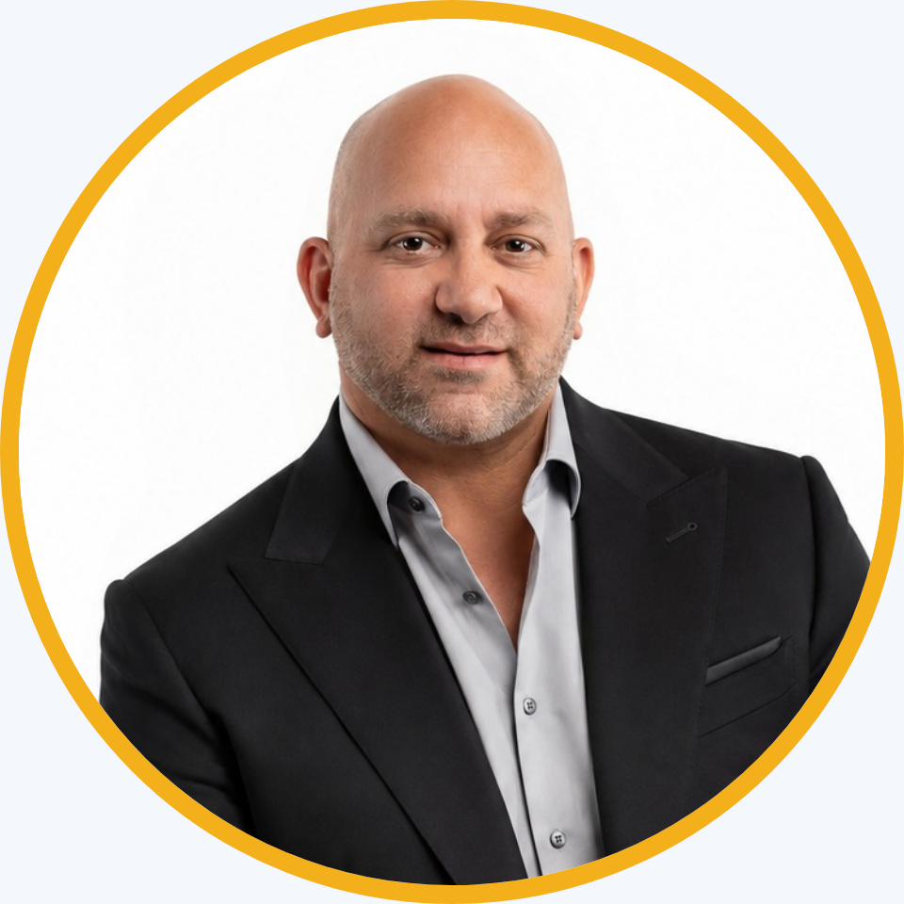
Marc Nieto
FOUNDER, REMEX
EMAIL
events@remexct.com
PHONE
914-409-5555
WEB
remexct.com
FACEBOOK
REMEx on Facebook
BIO
Read Marc's bio at remexct.com
REMEx · Venue partners · 14

